Slide 1
Shark Attacks Incidents and Attacks Analysis
Connor Loudermilk

Slide 2
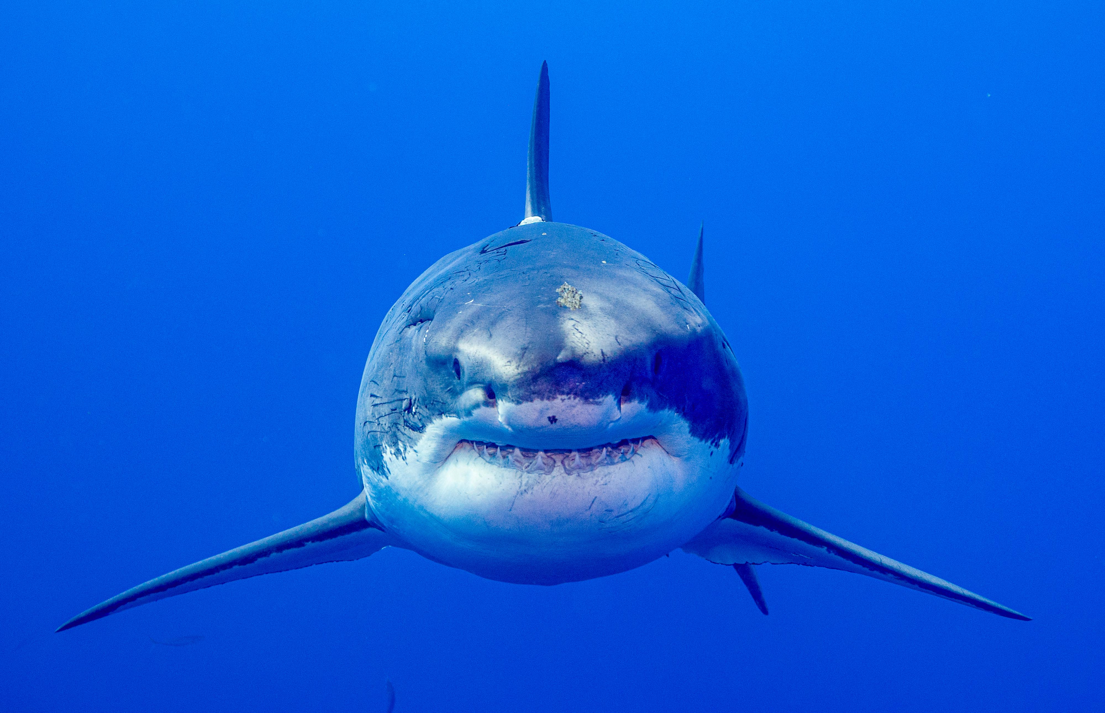
Overview
Cleaning Data
Common Themes
Data Comparison
Found patterns

Slide 3
Data Set- Global Shark Attack File – International Shark Research Institute
Date
Year
Country
Sex of Victim
Injuries
Fatality
Time of Day
Species
Composed of 7,013 Shark Attacks/Incidents
Over 14 Columns
Used 8 due to major inconsistencies

Slide 4
Cleaning Data and Issues
Different Countries Contribute
Different dating
Spellings
Shark Species
Included Length or “Large Shark”
Scientific Names
Inconsistencies Throughout
Integers vs. Strings
Different Verbiage
Very unclean and Unorganized Data

Slide 5
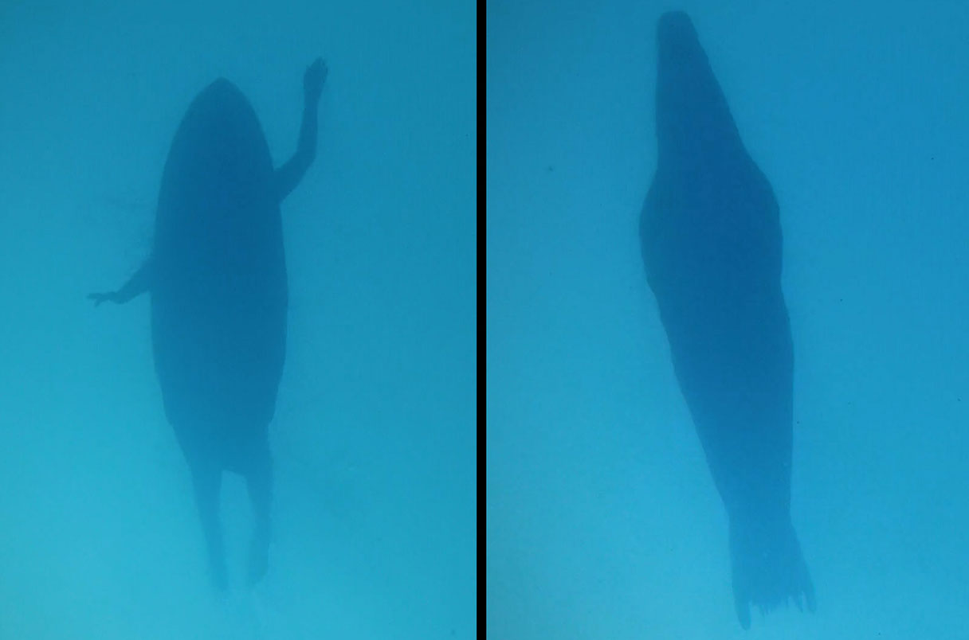
Main Analysis
Do some factors such as age, time, activity, region, and gender have a direct correlation to being in an incident or attack?

Slide 6
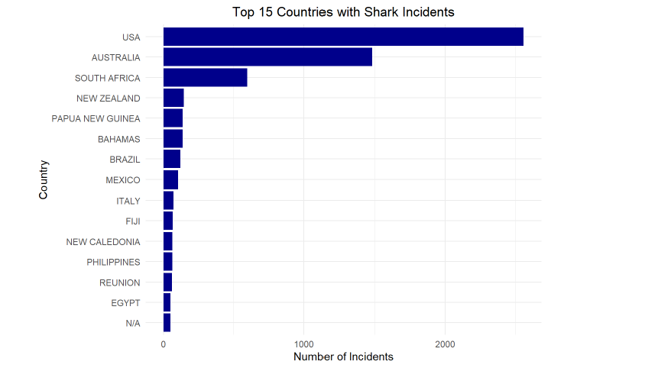
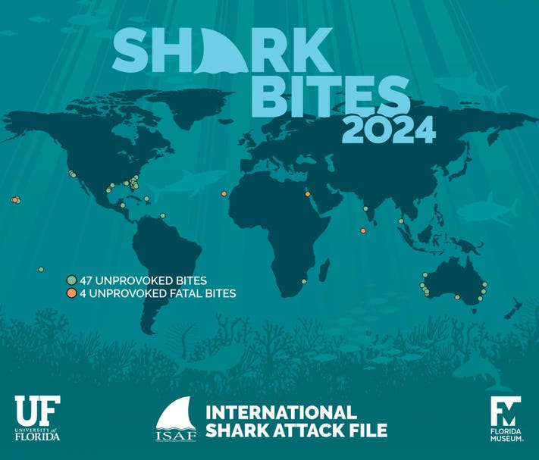
Top 15 Countries for Shark Incidents

Slide 7
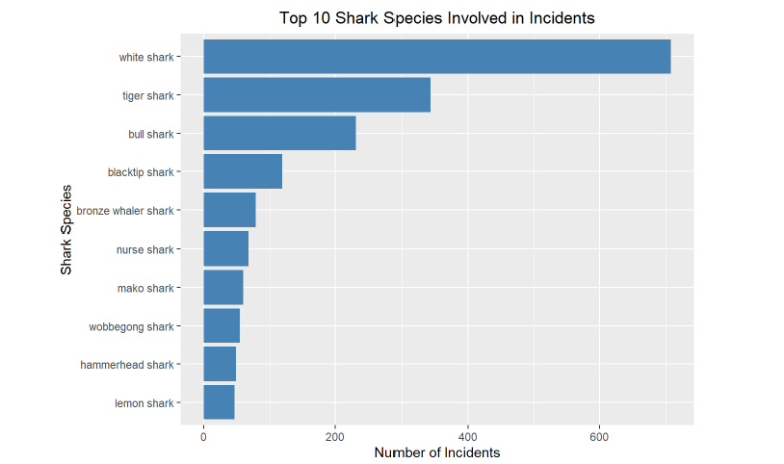
Sharks at fault
Many Attacks/Incidents result in Unknown Species
1.Great White Shark
2.Tiger Shark
3.Bull Shark
CI Great White Sharks:
29.3%-33.1%
P-Value Great White Shark-
<1.03e- 71

Slide 8
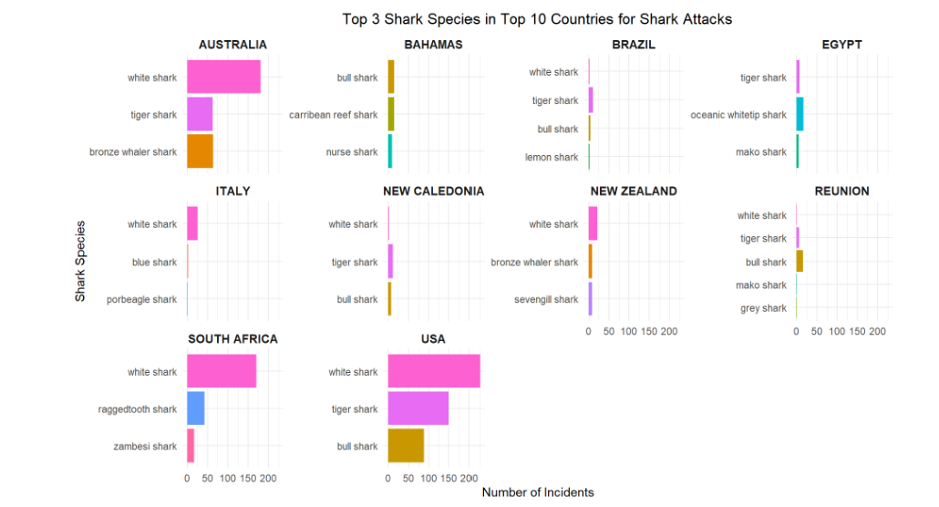

Slide 9
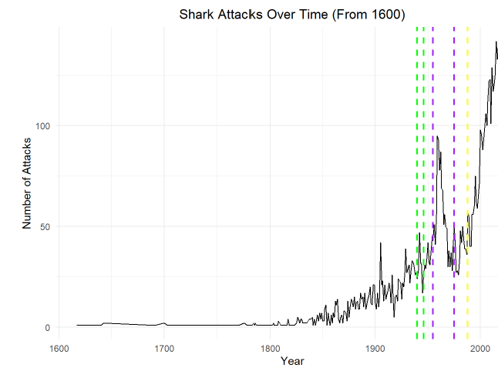
Time-Line Incidents
Green – World War 2
Purple – Vietnam War
Yellow – Cell phones become common globally

Slide 10
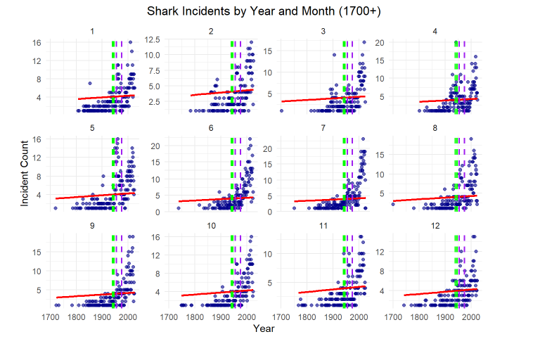
Month Break Down
Many outliers fall in time periods of naval combat
When broken down by months much easier to see.

Slide 11
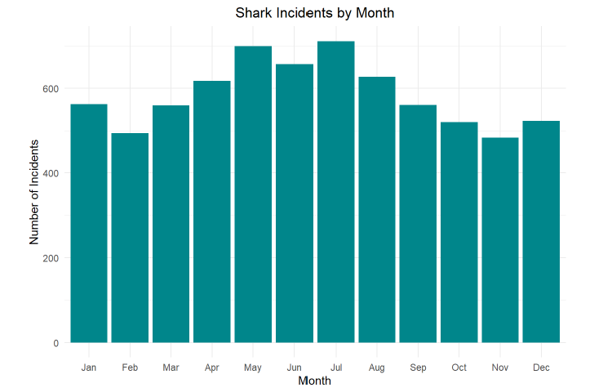
Months of Activity
Skewed Distribution Based on Seasons

Slide 12
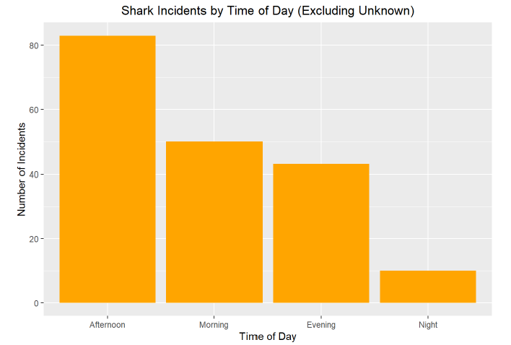
Times of Incident
8.3x more likely afternoon than night
p-value < 2.2e-16

Slide 13
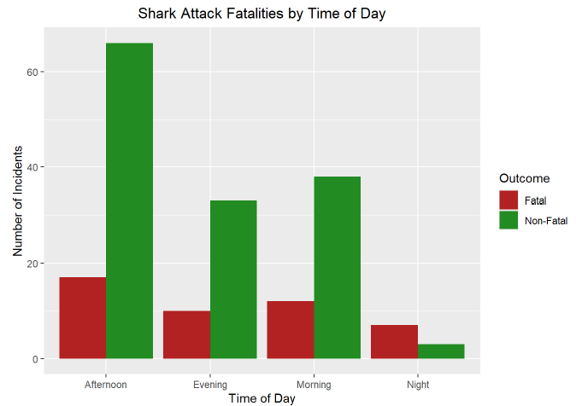
Time of Day vs. Fatality
p-value < 0.007811
3.16x more likely to be in a fatal if at night (in respect to population sizes)

Slide 14
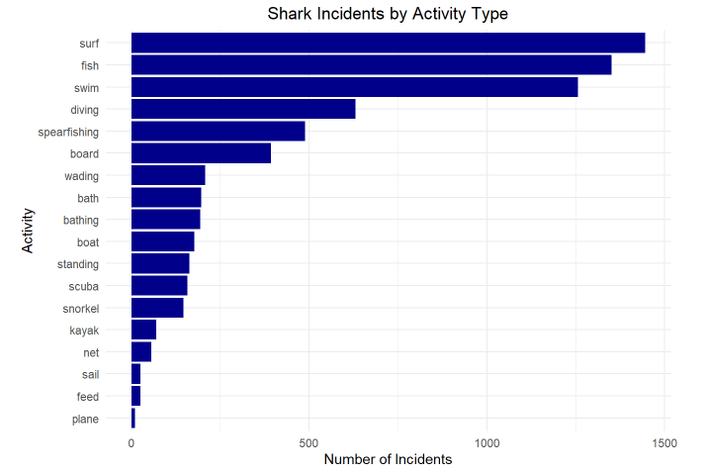
Activities Driving Incidents
P-Value < 2.2e-16
(fish + surf + swim)
95% confident that 55.72% – 58.05% of population incidents can be tied to these activities.

Slide 15
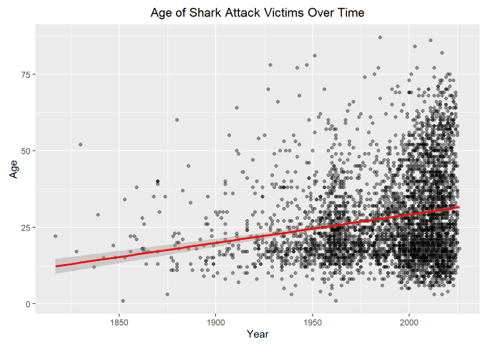
Age Relation to Incidents/Attacks
p-value: < 2.2e-16
Mean: 28.11234
CI: ages 27.65 – 28.57

Slide 16
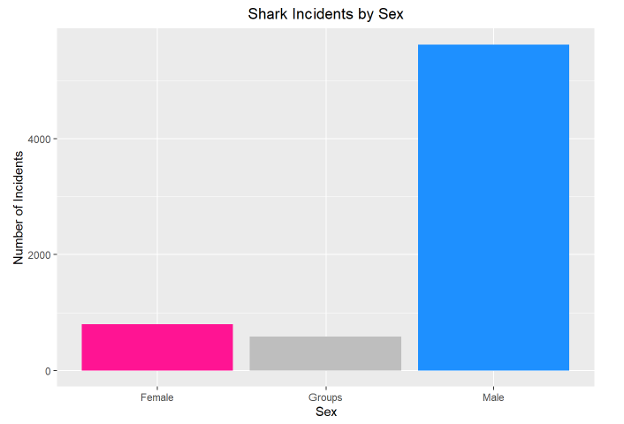
Gender
Groups - Mixed gender
Males are 7.06x more likely

Slide 17
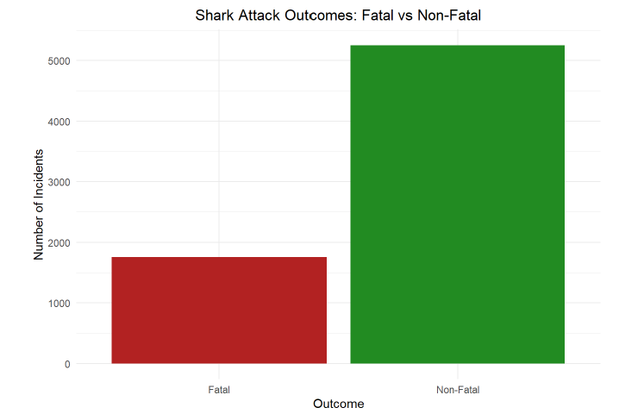
Fatalities
P-value: < 2.2e-16
CI Survival:
0.7391 – 0.759502
(74.9494%)

Slide 18
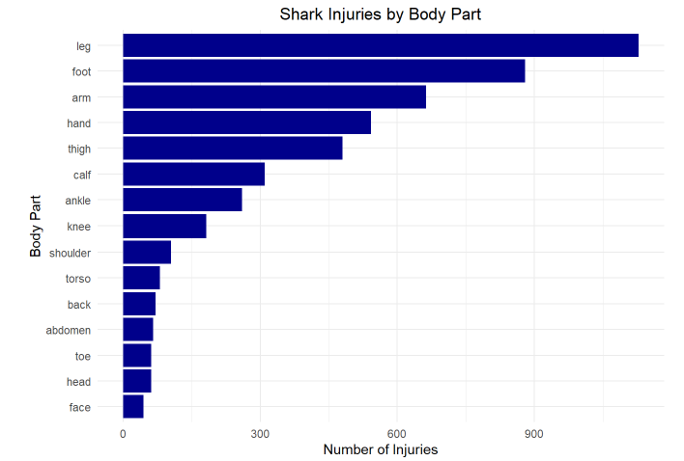
Injury Type
P-Value < 2.2e-16
95% confident that in an attack the population will suffer from the top three injuries at a rate of 34.63% to 36.889%

Slide 19
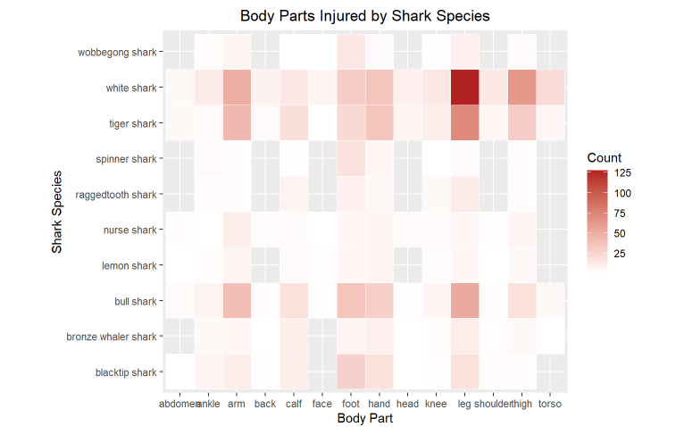
Sharks and Injury Correlation
Heat map shows relationship between type of shark and what body part an injury is sustained on.

Slide 20
Conclusion:
Events that increase likeliness of attack:
Location: USA, Australia, South Africa
Shark Species: Great White, Tiger Shark, Bull Shark
Activity: Fishing, swimming, or Surfing
Time of Day: Afternoon
(More chance of fatality at night)
If in incident or attack likelihood of dying is lower than believed but will likely suffer injuries to the legs, arms, and/foot
Although all increase likelihood cannot be proven whether some events directly correlate to each other due to the lack of data quality. Some events logic depend on one another such as activity and time of day, but they can’t be proven.
Results found give opportunity to fill in the seriously large amounts of gaps in the international data set.

